Slide 1

By Dexter Kim
Notes:
Hello everyone,
This is Dexter, iOS Architect.
Today I’m going to share with you about some great features introduced in WWDC18.

Slide 2
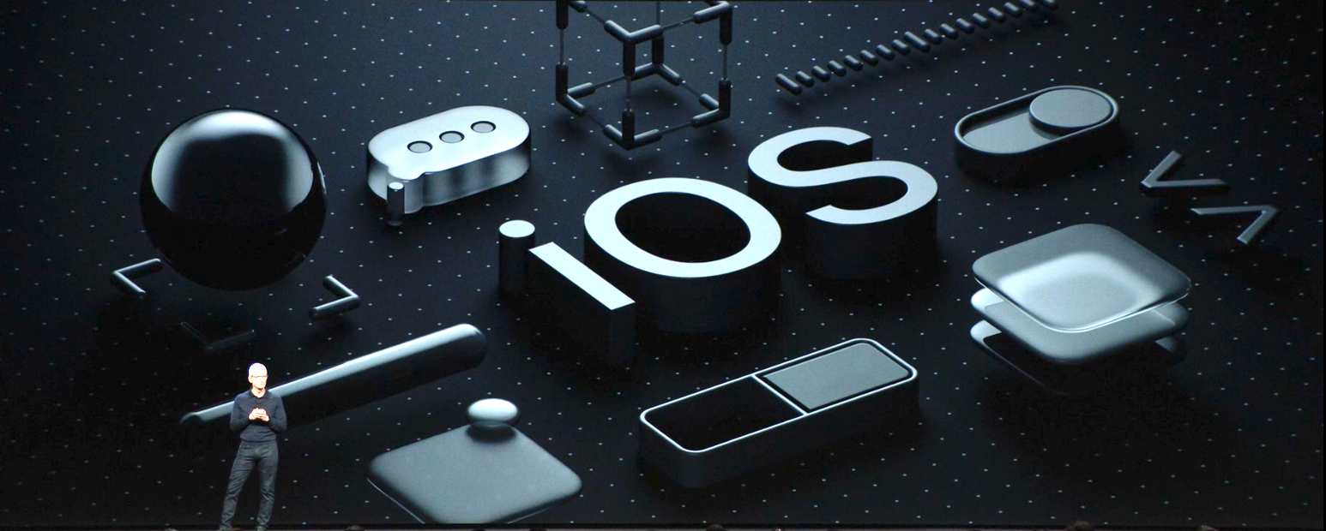
Notes:
There are several platforms Apple provides but I’m going to tell you about iOS specifically since our products are for iOS.

Slide 3
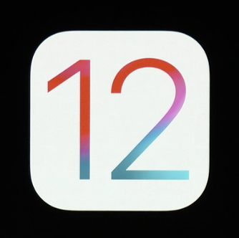
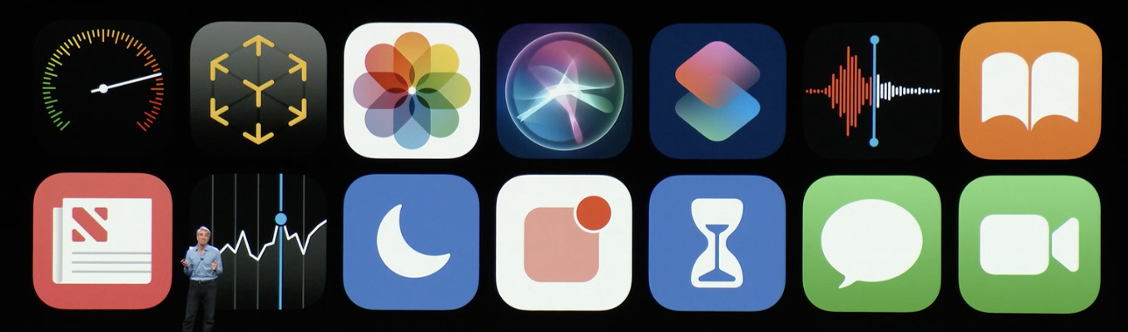
Notes:
In this year, Apple announced iOS12 including some great features.
Let’s start with performance first.

Slide 4

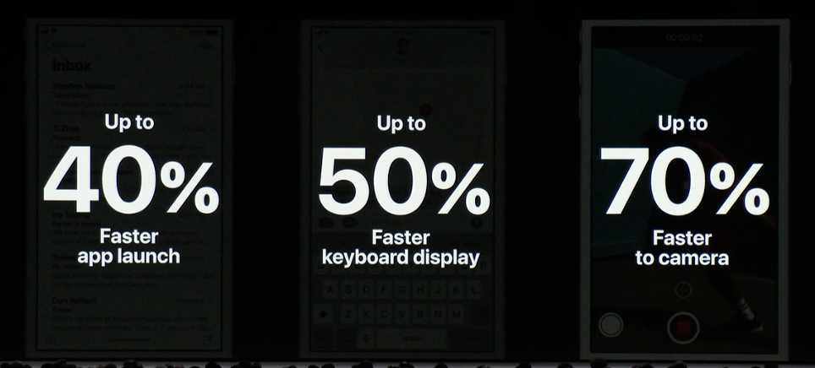
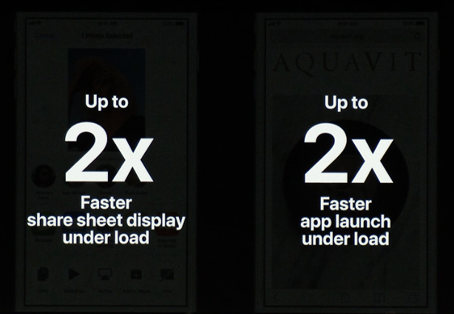
performance
Notes:
Apple has concerned a lot regarding the performance and they actually improved a lot in iOS12.
40% faster app launch
50% faster keyboard display
70% faster to camera
And also
2x faster share sheet display
These improvements work throughout all of devices which are able to download iOS12.

Slide 5
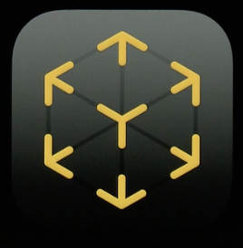
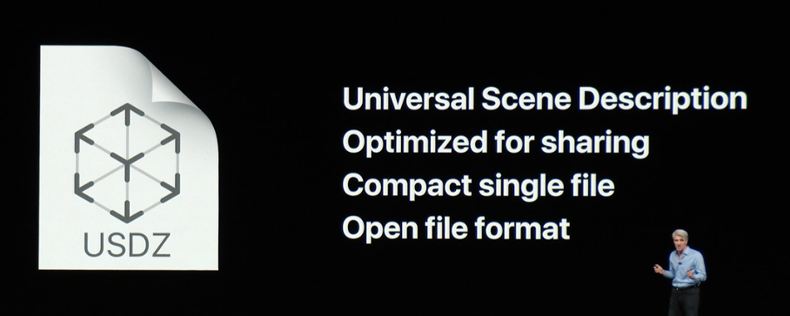
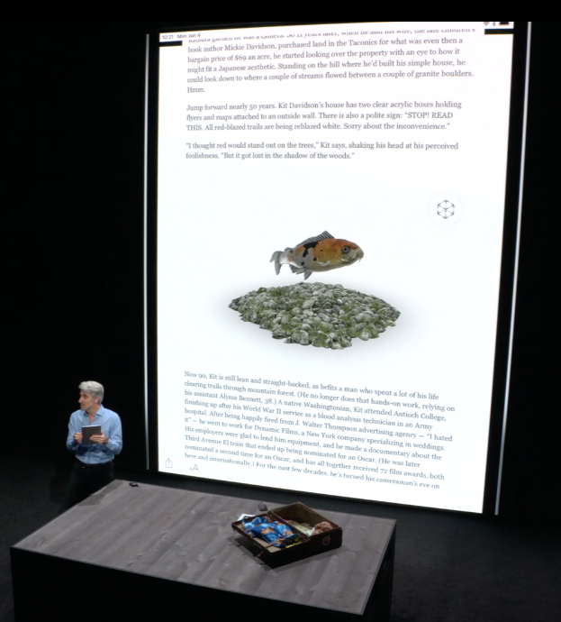
Ar (Augment reality)
Notes:
Next AR
Apple introduced a new file format for AR called USDZ.
It’s optimized for sharing. So you can send it to others through the iMessage or add it on your document like adding an image file.
Also, if you can tap the AR icon on the image, then you will see the 360 degree AR image and you can move it around with your finger to see all of side of the object.
With this format, maybe later we can add a USDZ file for a phone device model on the HUP flow (which is Hardware Upgrade) so that users can see the detail phone design through the AR.
In our future, it’s going to be in everywhere like image or video file.

Slide 6
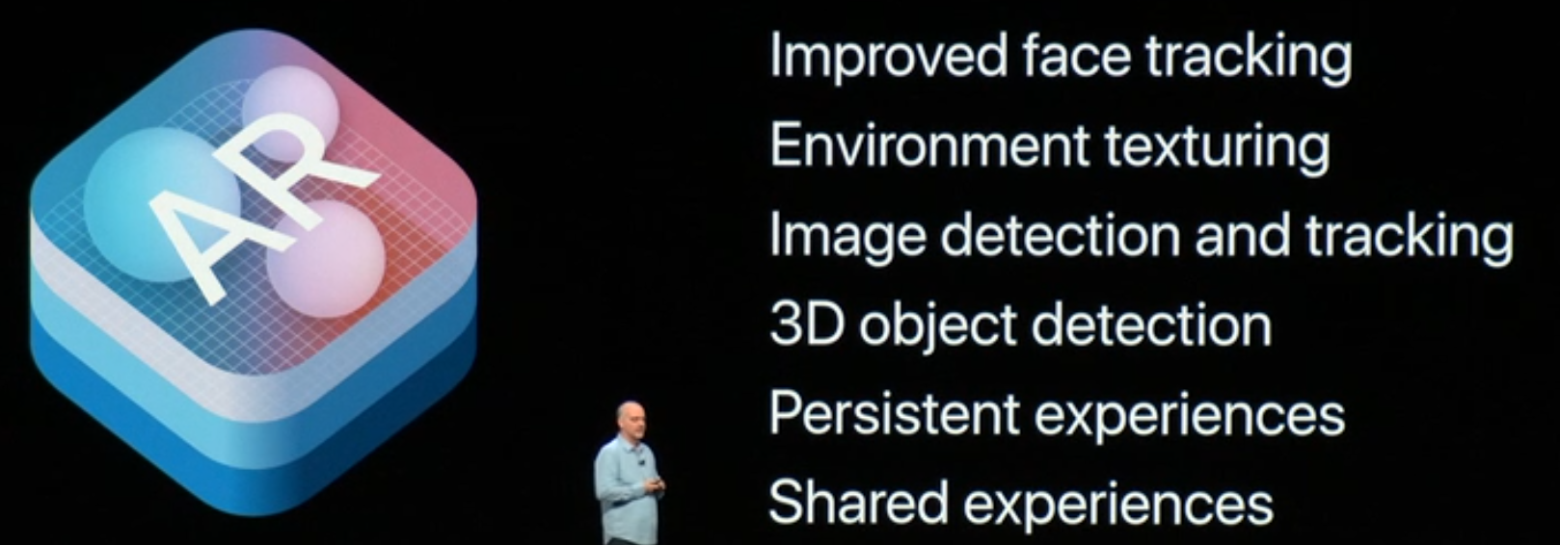
Ar (Augment reality) – ARKit 2
Notes:
In order to use AR on iOS12, you need to adopt ARKit 2.
[Read content]
Especially, one of interesting thing is shared experiences.

Slide 7
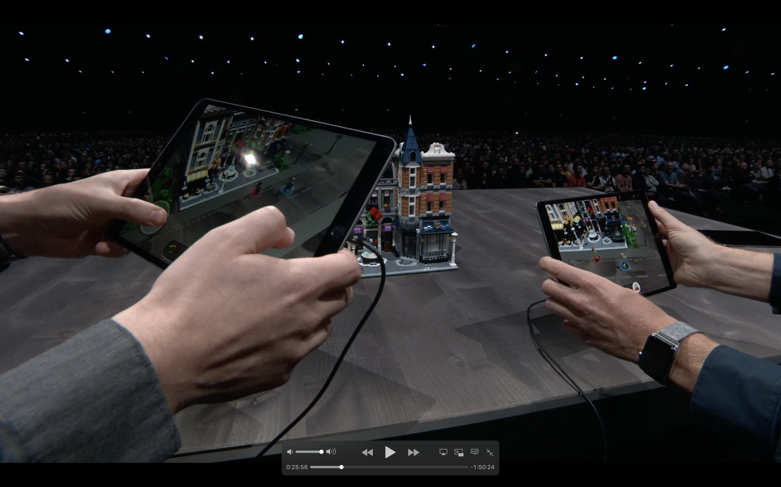
Ar (Augment reality) – Lego
Notes:
This is the game LEGO created. As you can see, two guys are pointing their device to the one place but in different angle.
And they’re playing game with one argument. This is really amazing and it’s going to be a new trended game style.

Slide 8
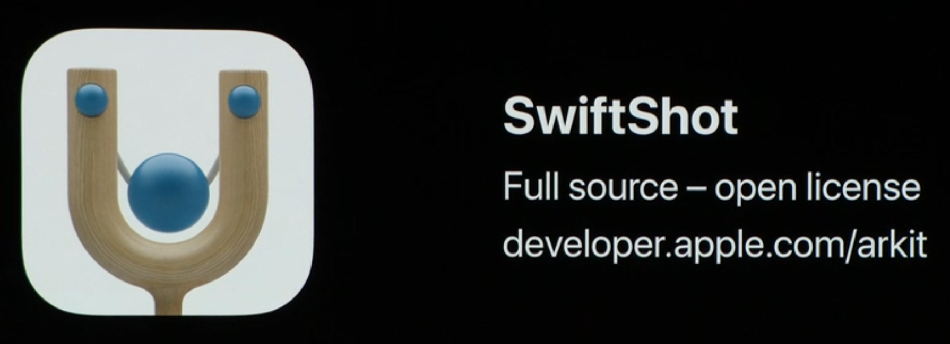
Ar (Augment reality) – Sample App
Notes:
Also, Apple provides a open licensed app called SwiftShot.

Slide 9

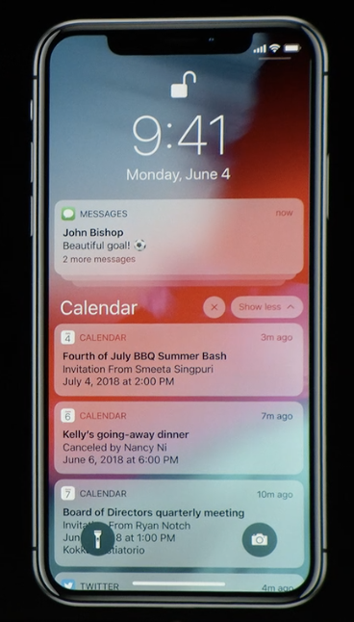
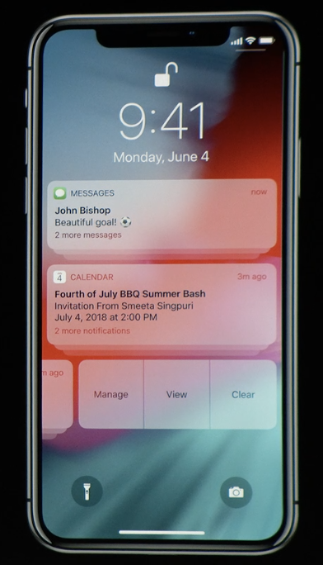
Group notification
Notes:
There are some small updates.
First, it’s the group notification.
You can group a bunch of notifications by each app. You can actually expand and collapse, also, you can swipe left to manage the group.

Slide 10
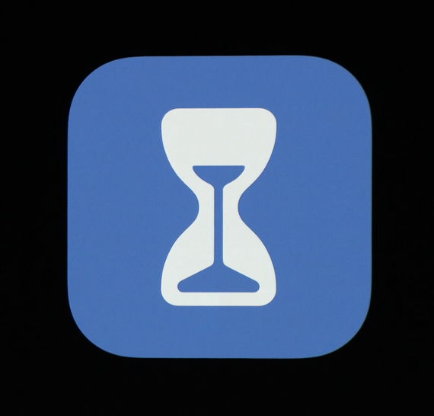
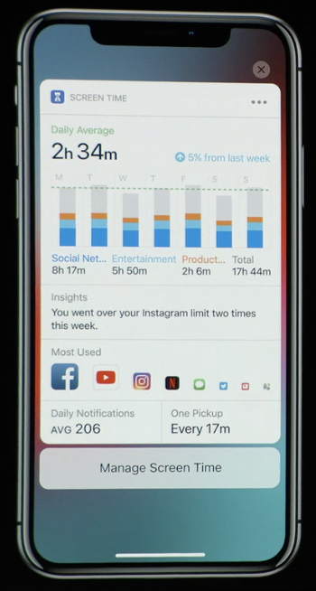
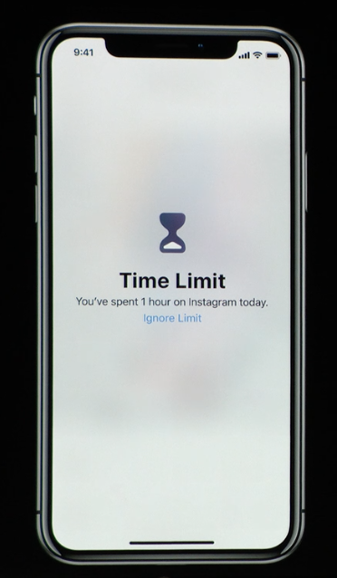
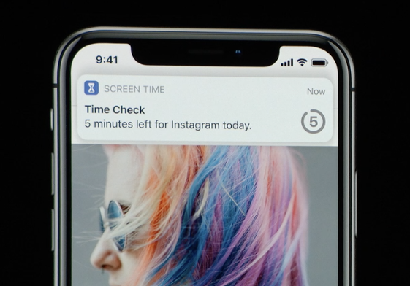
Screen Time
Reports
Weekly Activity Summary
App Usage
Pickups
Notifications
App Limits
Reminders
Allowances
Notes:
The other one is ScreenTime
There are two features for Screen Time.
[Read Content]
It’s going to be a great way to avoid addiction of using phone.
That’s the Screen Time.

Slide 11

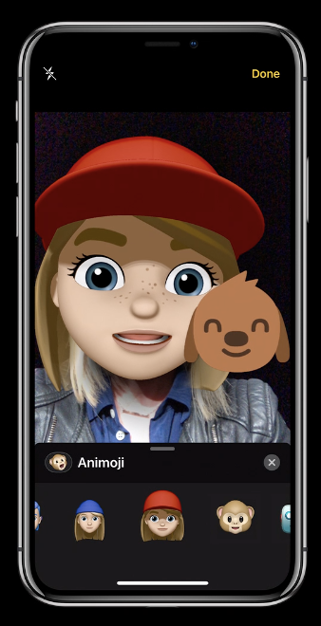
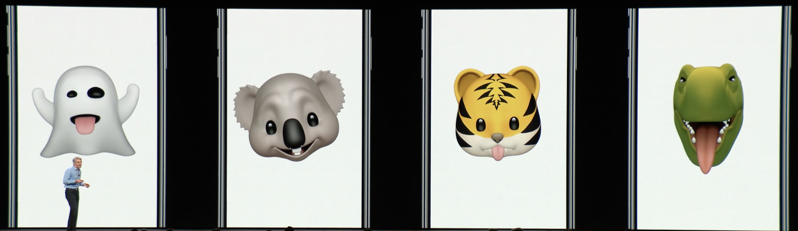
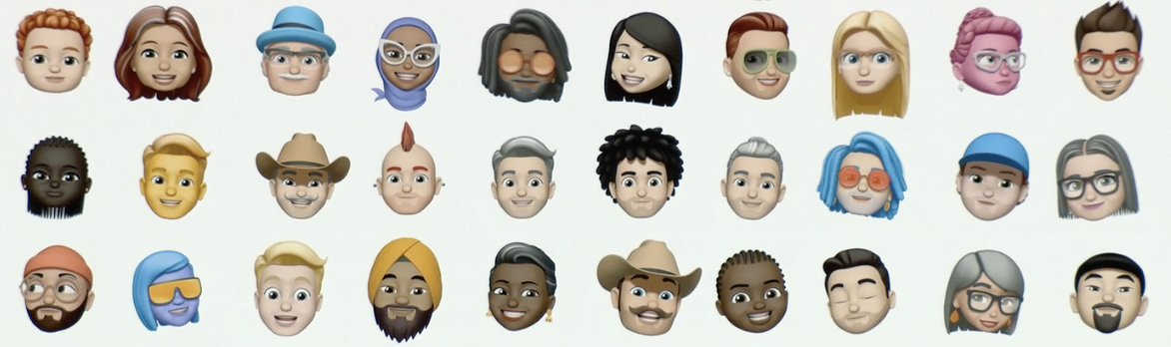
Message
Tongue Detection for Animoji
Additional Animoji Cahracters
Memoji – Personal Animoji
Notes:
Next, Message
There are three updates for Message.
[read content]

Slide 12

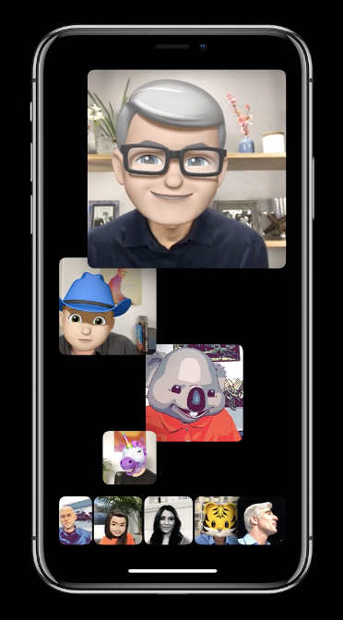

Facetime
Group Facetime
Up to 32 people
With Memoji
Notes:
And then Facetime
One big change is Group facetime
You can invite up to 32 people and you can apply for your memoji on your face.

Slide 13
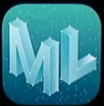
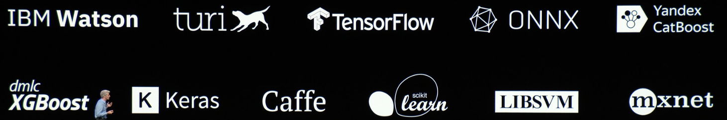
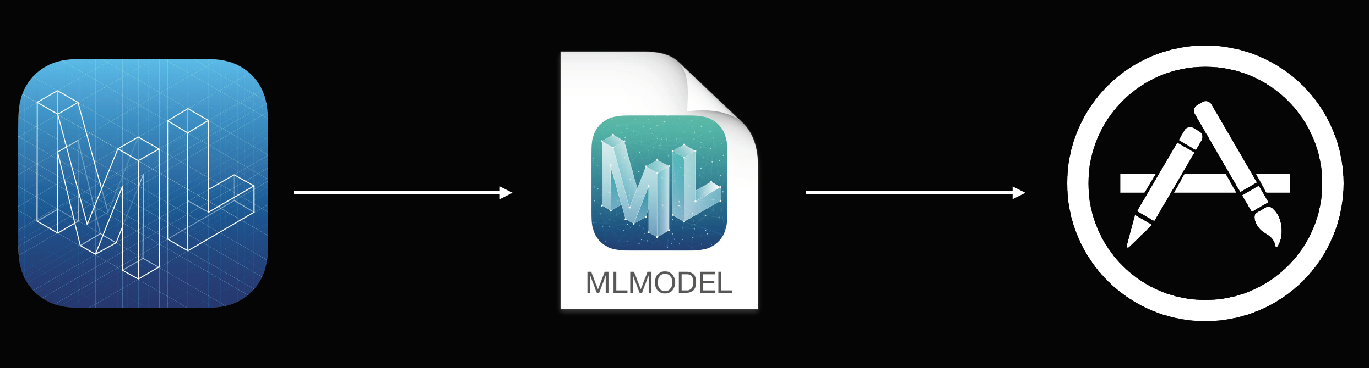

ML - Machine learning
Create ML
Vision and Natural Language
Custom data
Built in Swift
Better performance of training
Core ML 2
Model Size
Performance
Customization
Notes:
One of new trended technologies is Machine Learning
So far, we have made a model with some modeling tools from these 3rd party companies. You have to use python with their tool, which is not familiar for the apple developers.
So, now Apple has a framework call Create ML.
It covers vision and natural language.
And you can customize data, which is already existed.
And it’s built in Swift. So, apple developers can adopt to use easily.
And it has great performance of training in terms of speed and model size.
On top of that, Apple also introduced the CoreML 2, which has great improved.
These frameworks will make a developer to make an Machine learning app.

Slide 14
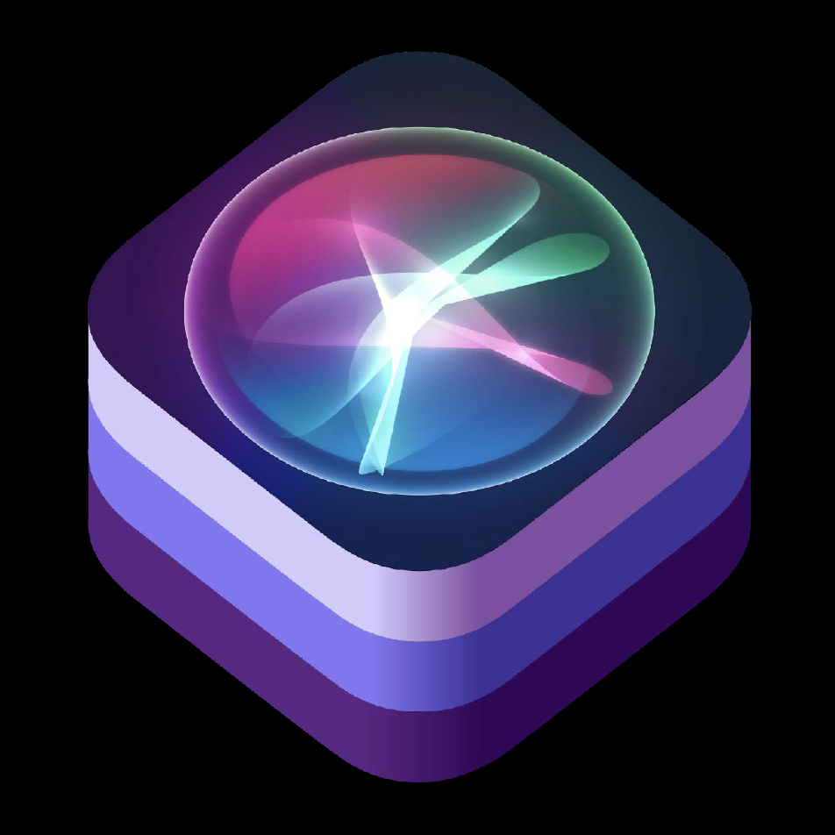

Siri shortcuts
Notes:
Now, the most interesting feature in iOS12 is Shortcuts.
The reason why I’m excited about is because this feature will be able to provide convenient way to our customer to access the app and execute some our features in the background.

Slide 15
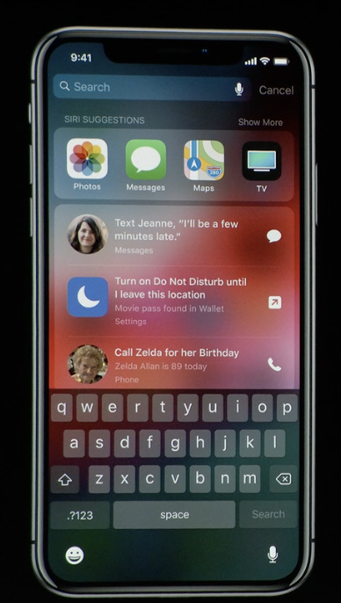
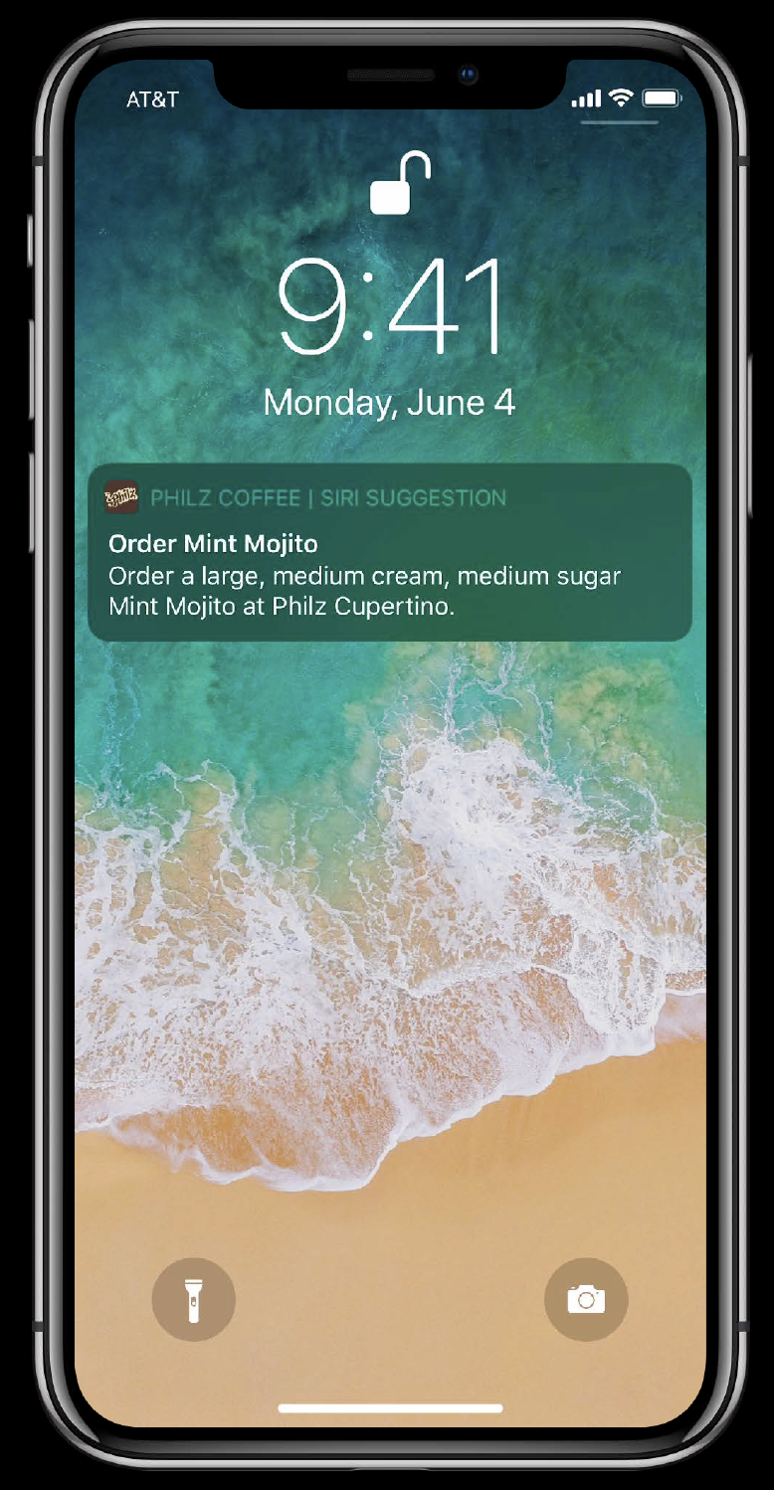
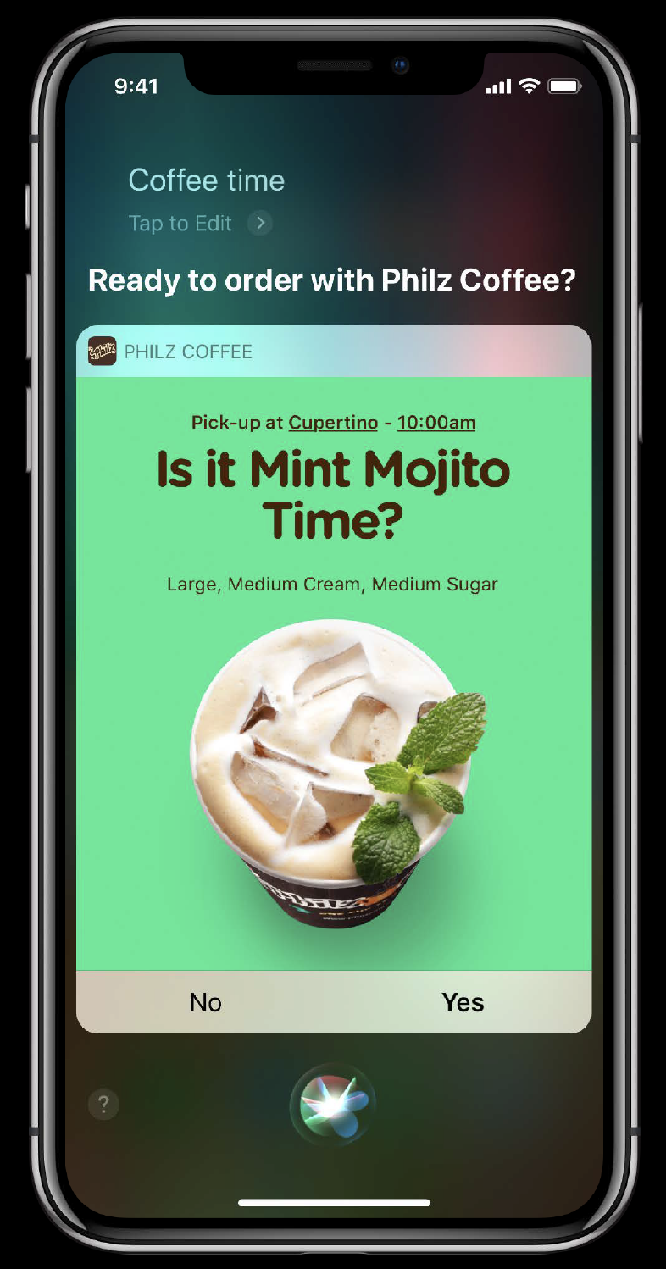
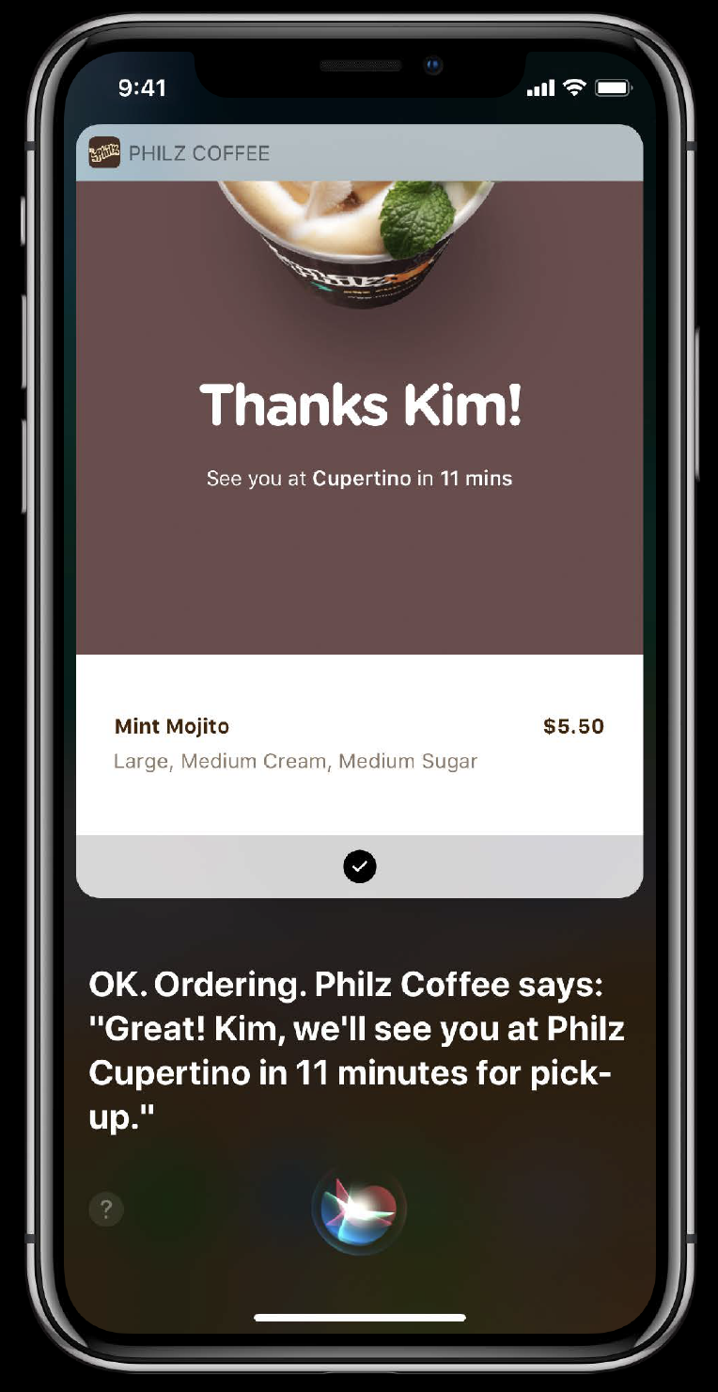
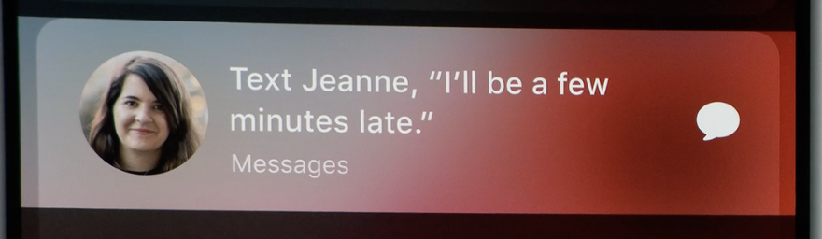
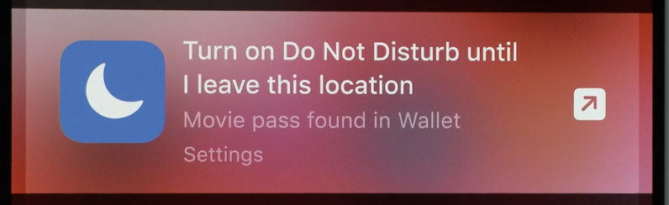
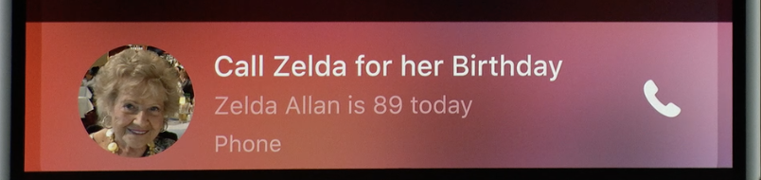
Siri shortcuts – SIRI SUGGESTION
Notes:
Siri shortcuts has suggestion feature.
Siri suggests the pattern that you defined previously and you can execute through the suggestion without launching the app on either lock screen or search screen.

Slide 16
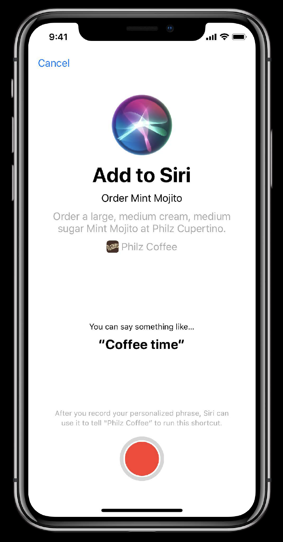
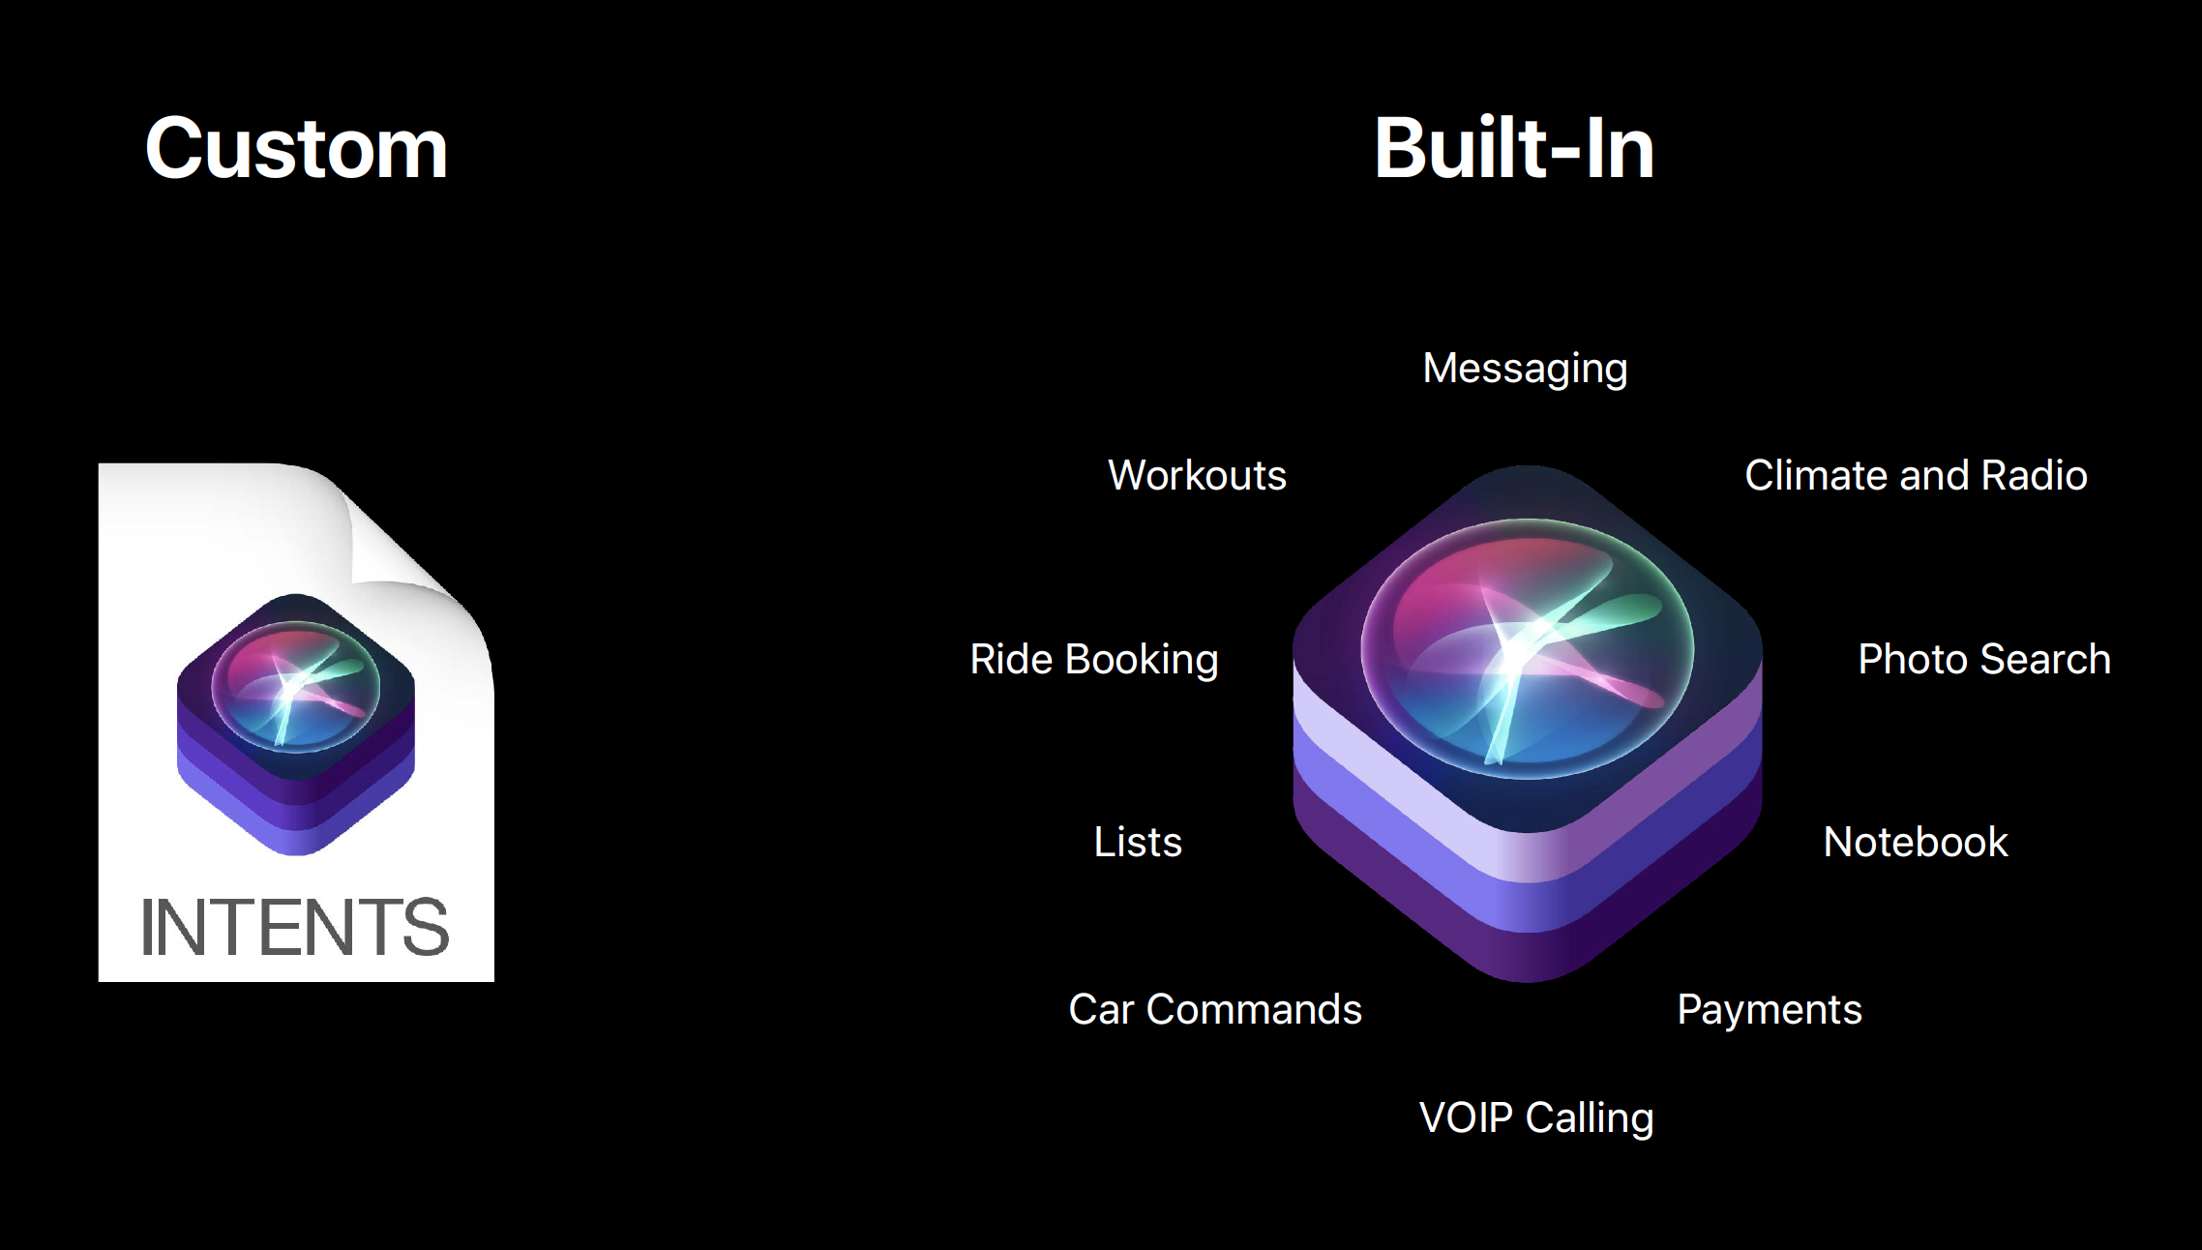
Siri shortcuts – CUSTOM SHORTCUT
Notes:
Basically, You can use some shortcuts which are already built-in but you can also customize it. For example, `Coffee time` as you can see on the previous slide and apply it to the app.

Slide 17
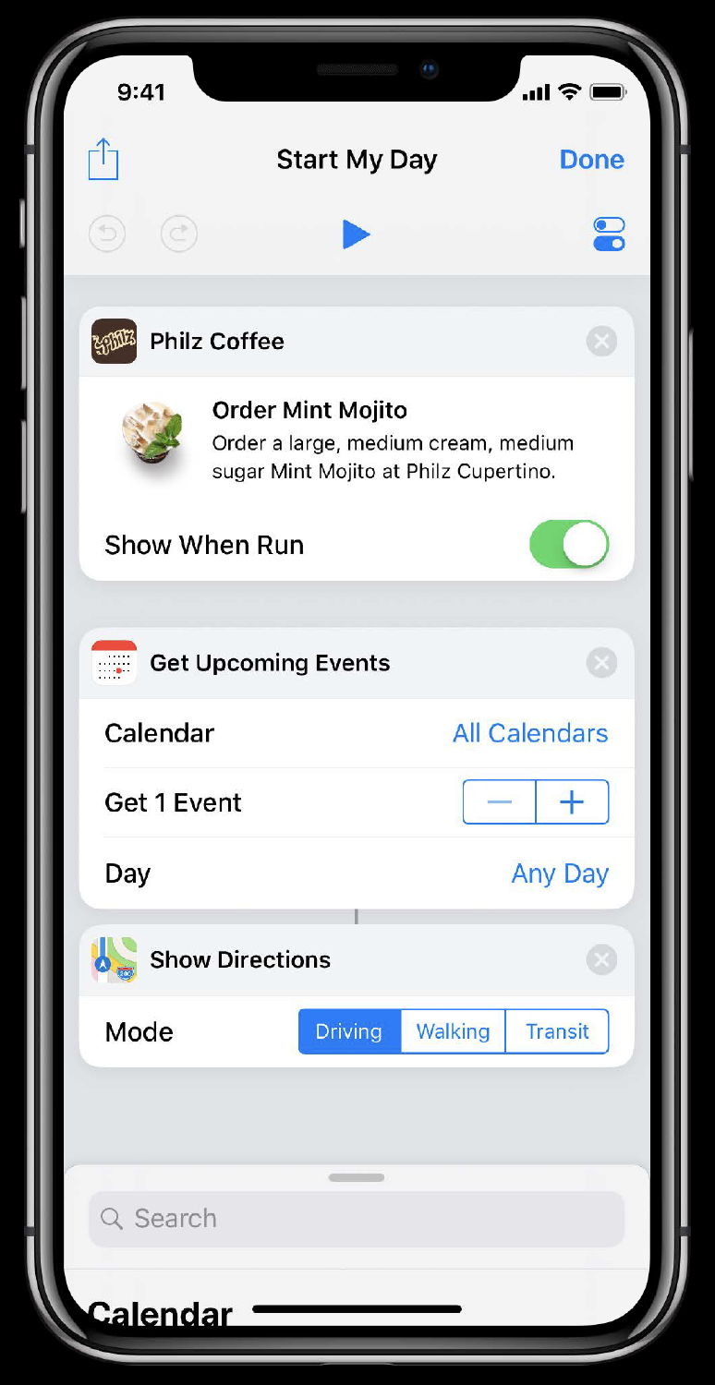
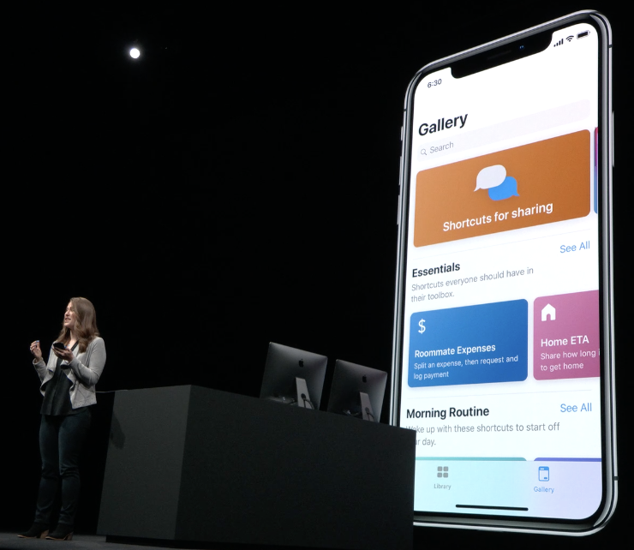
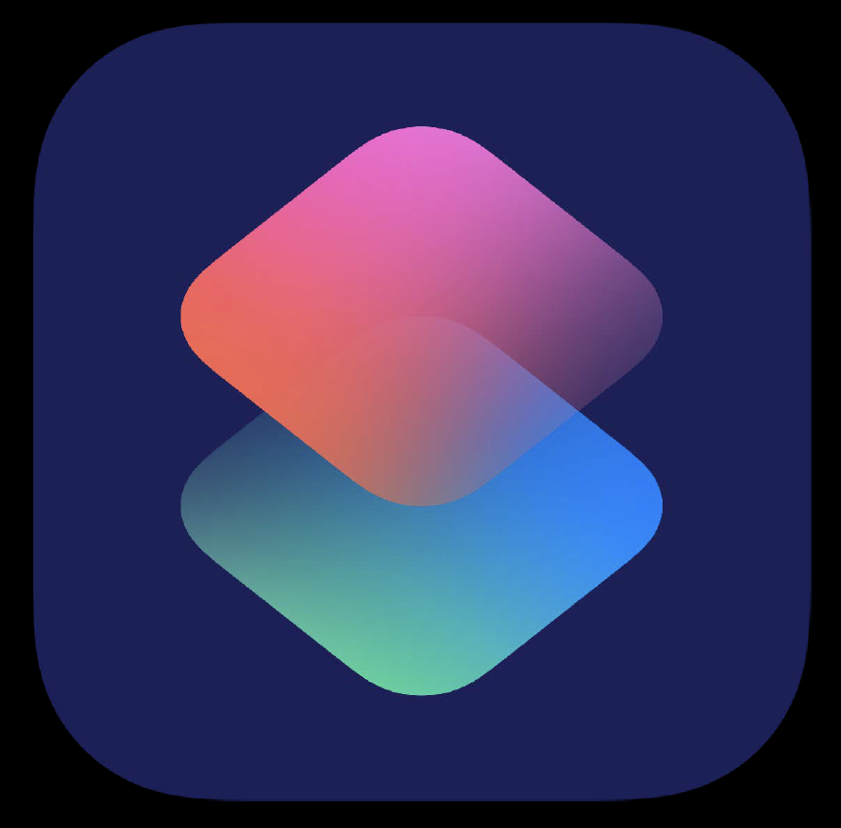
SHORTCUTS APP
Notes:
There is a shortcuts app, which provides a bunch of shortcuts on the Gallery tap you can download.
On the left hand side on the tabbar .there is a library tap and it shows all of shortcuts you have. You can tap one of shortcuts and customize it.
You can actually add multiple shortcuts and run them by one shortcuts. It’s like defining your pattern. For example ”Start My Day”. It has multiple shortcuts in it and you can run them up at the same time.

Slide 18
Siri shortcuts – Let’s Try it out!
Challenges for Rogers/Fido
Data Balance (My Usage, My Remaining)
Payment / Current Balance
Data TopUp
Notes:
So, now what?
We should concern about how to apply for this shortcuts for our app.
There could be some challenges we can try out.
For example,
“my current data balance.”
“Show me my Rogers bill”
“Add one time data top-up”
And so on.
So, I’ll try to implement one shortcut for FIDO app as POC. Once it’s done, I’ll share with you guys later.

Slide 19

Thank you!
Notes:
That’s it. Any Questions?
Thanks!

